Slide 1

PRIMEZ ROUTER SALES DATA
Exploratory Data Analysis
by EVALINE WANJIKU

Slide 2
Understanding Primez Router Sales Data

Slide 3

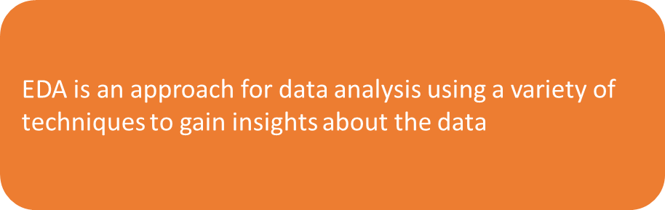
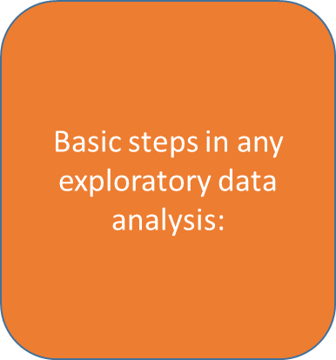
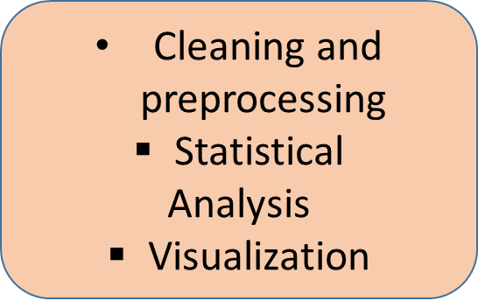
What is ExploratorY DatA Analysis

Slide 4




IMPORTANCE OF EDA
Improve understanding of variables by extracting averages, mean, minimum, and maximum values, etc.
Discover errors, outliers, and missing values in the data

Slide 5
Understanding Primez Router Sales Data
Purpose:
Welcome, everyone, to the Primez Router Sales Analysis Presentation.
The primary objective today is to delve into our router sales data to uncover crucial insights.
Key Focus Points:
Total Orders: Understanding the volume of router purchases.
Popular Router: Identifying our most sought-after router model.
Sales Across States: Exploring variations in sales across regions.
Return Analysis: Examining reasons and patterns for product returns.
Additional Insights: Unveiling three compelling trends within the data.
Notes:
In this presentation, we will be focusing on several key aspects of Primez's router sales and returns. Firstly, we will delve into understanding the volume of router purchases by analyzing the total orders placed. Secondly, we aim to pinpoint our most sought-after router model, shedding light on the preferences of our customer base. Exploring variations in sales across different states will help us identify regions with potential growth opportunities. Additionally, we will conduct a comprehensive analysis of product returns, examining reasons behind returns and identifying any recurring patterns. Lastly, we will uncover three compelling trends within our data, providing valuable additional insights that can aid in strategic decision-making for Primez.

Slide 6
PACKAGES AND DATA IMPORT
Step 1 : Import pandas to the workplace.
“Import pandas”
Step 2 : Read data/dataset into Pandas dataframe. Different input formats include:
Excel : read_excel
CSV: read_csv
JSON: read_json
HTML and many more

Slide 7
Other methods to get a quick look on the data:
Describe() : Summarizes the central tendency, dispersion and shape of a dataset’s distribution, excluding NaN values.
Syntax: merged_df.describe()
Info() :Prints a concise summary of the dataframe. This method prints information about a dataframe including the index dtype and columns, non-null values and memory usage.
Syntax: merged_df.info()
Descriptive Statistics

Slide 8
3. Null values
Handling
Detecting
Handling null values:
Dropping the rows with null values: dropna() function is used to delete rows or columns with null values.
Replacing missing values: fillna() function can fill the missing values with a special value value like mean or median.
Detecting Null-values:
Isnull(): It is used as an alias for dataframe.isna(). This function returns the dataframe with boolean values indicating missing values.
Syntax : merged_df.isnull()

Slide 9
4. VISUALIZATION
Univariate: Looking at one variable/column at a time
Bar-graph
Histograms
Boxplot
Multivariate : Looking at relationship between two or more variables
Scatter plots
Pie plots
seaborn

Slide 10
Bar-Graph,Histogram and Boxplot
Bar graph: A bar plot is a plot that presents data with rectangular bars with lengths proportional to the values that they represent.
Boxplot : Depicts numerical data graphically through their quartiles. The box extends from the Q1 to Q3 quartile values of the data, with a line at the median (Q2).
Histogram: A histogram is a representation of the distribution of data.

Slide 11
Total Number of Orders
The bar chart prominently displays bars adding up to 499 orders,
Notes:
The total number of router orders, represented visually through a bar chart, distinctly illustrates the significant volume of sales. The bar chart prominently displays a bar indicating 499 orders, accurately labeled to depict the scale of demand. This figure, accounting for the total number of orders, underscores a robust and noteworthy customer demand for Primez's routers.

Slide 12
Most Popular Router Ordered
A bar graph has been employed to highlight the preference for various router models, with a distinctive emphasis on the segment representing BAS-48-1 C, depicting 110 orders.
This visualization succinctly illustrates the popularity of router models, notably highlighting BAS-48-1 C.
Notes:
BAS-48-1 C emerges as the top choice among customers, as evidenced by its significantly higher order count compared to other models. This insight suggests a clear inclination towards this particular router model among our customer base.

Slide 13
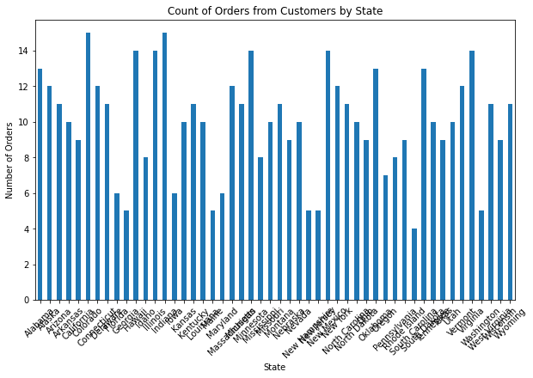
A bar chart indicating sales across states.
Displayed is a bar chart delineating sales figures across different states.
South Carolina is distinctly highlighted, representing 4 orders within the chart.
Notes:
The sales data indicates a potential area for growth in South Carolina. With only 4 orders recorded in this region, there exists an opportunity to enhance our sales efforts. Strategically targeting this market could lead to increased market penetration and improved sales performance in South Carolina.

Slide 14
A comprehensive pie chart is presented, outlining the distribution of return reasons.
The chart distinctly segments reasons into Defective (110), Incorrect (342), and Other (49).
Notes:
Understanding the reasons behind product returns is pivotal in ensuring customer satisfaction and operational efficiency. The data showcases three primary reasons for returns—Defective, Incorrect, and Other—each carrying its weight in influencing customer experience and overall satisfaction. Identifying and addressing these reasons can significantly impact our service quality and customer retention strategies.

Slide 15
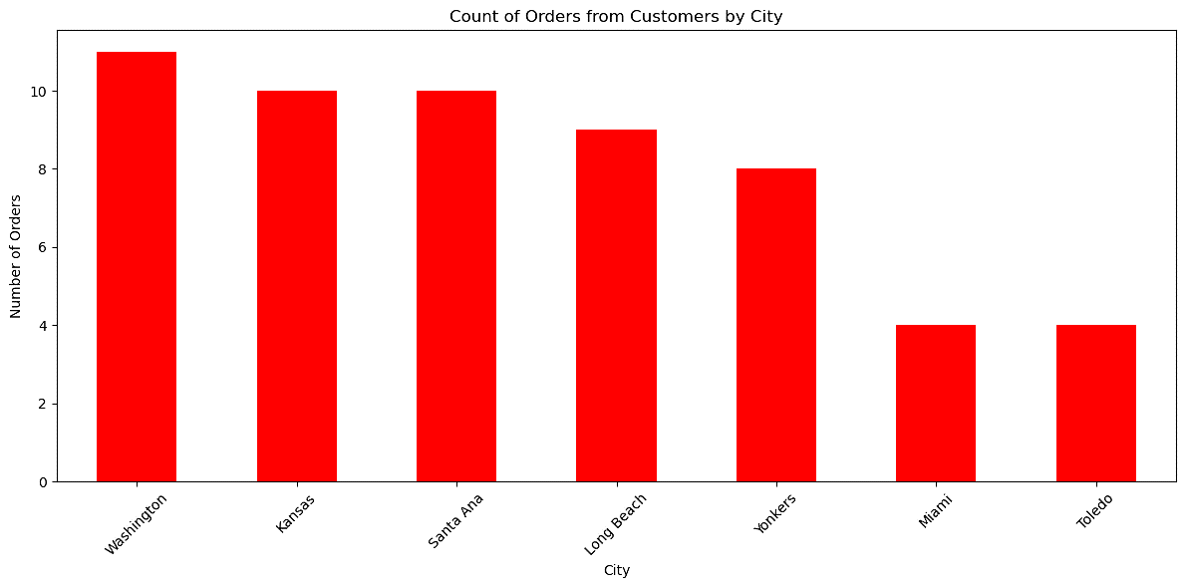
A bar graph for the count of orders from customers by city

Slide 16
ROUTER PREFERENCE
The most desired router model aligns with a description of a Basic Switch 10/100/1000 BaseT 48 port, exhibiting significant demand.
Conversely, the model with the least orders corresponds to a Basic Switch 10/100/1000 BaseT 24 port, which was ordered only once.
Notes:
The most desired router model aligns with a description of a Basic Switch 10/100/1000 BaseT 48 port, exhibiting significant demand. Conversely, the model with the least orders corresponds to a Basic Switch 10/100/1000 BaseT 24 port, which was ordered only once. Understanding these varying preferences sheds light on specific customer needs and preferences within our product range.

Slide 17
ORDER COMPLETION RATE
All 499 orders processed were successfully completed.
Notes:
This outstanding completion rate showcases Primez's operational efficiency and commitment to fulfilling customer orders promptly and accurately, potentially contributing to enhanced customer satisfaction and loyalty.

Slide 18
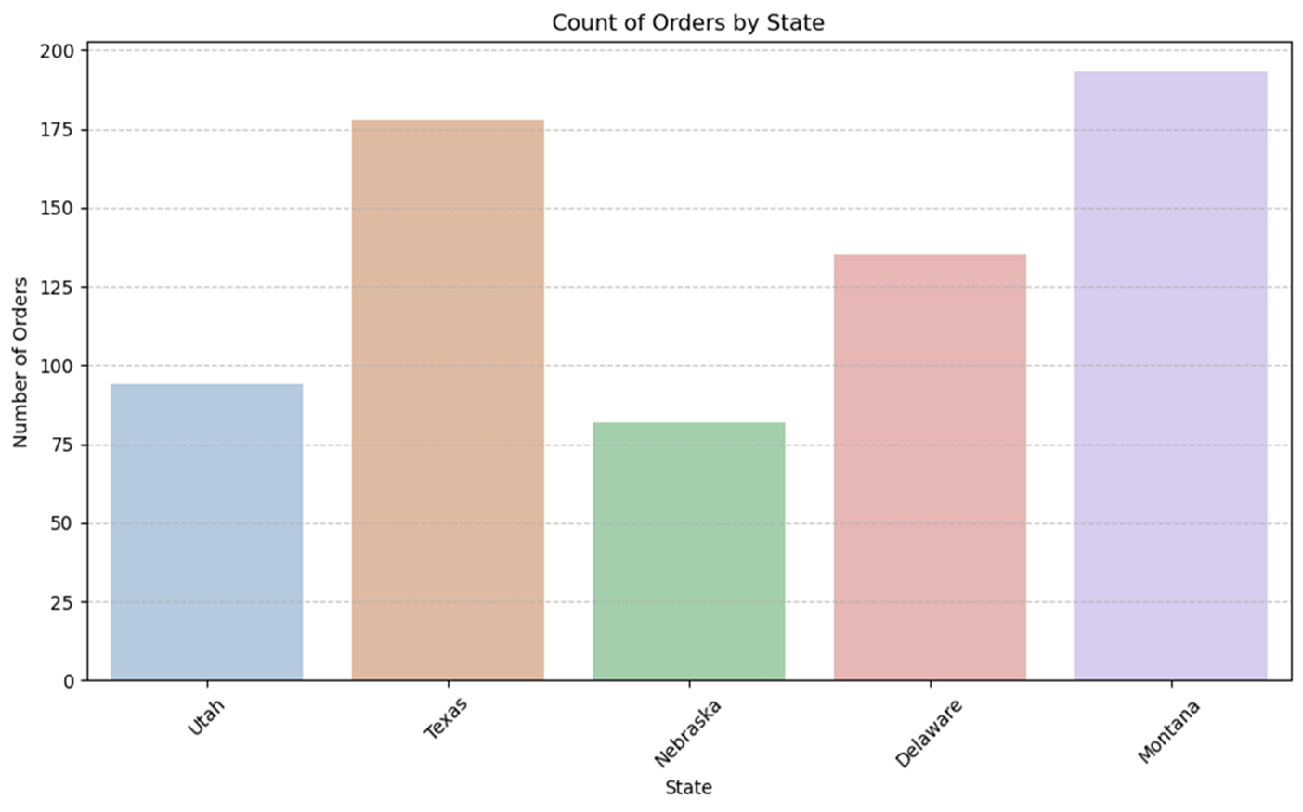
A Bar plot that shows the orders each state had
From this bar plot we can see Montana had the highest number of orders while Nebraska the least.

Slide 19
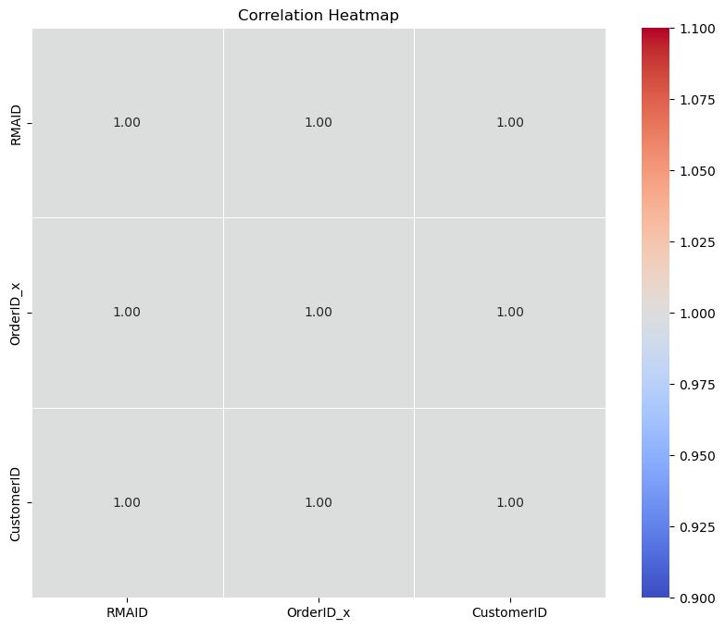
Correlation Heatmap
in our heatmap, the cell at the intersection of ‘RMAID’ and ‘OrderID’ is dark blue with a value of ‘0.90’. This indicates a strong positive correlation.
As the value of ‘RMAID’ increases, we would expect the value of ‘OrderID_x’ to increase as well.

Slide 20
Notably, the dataset pertaining to router information contains missing values within the status column.
Addressing these blank entries is essential for ensuring data accuracy and reliability in our analysis and decision-making processes.
Data Issues for Consideration

Slide 21
Total Orders: 499 router purchases signify robust demand.
Popular Router: BAS-48-1 C stands out with 110 orders, indicating high customer preference.
Sales Across States: Identified areas, like South Carolina, with opportunities for increased sales.
Return Analysis: Highlighted significant return reasons and specific patterns in return types.
Additional Insights: Explored three impactful trends revealing valuable market insights.
Conclusion/Recomendation
Notes:
In conclusion, the analysis of Primez's router sales data has unearthed pivotal insights crucial for strategic decision-making. The 499 router purchases underscore a robust demand in the market for our products. Among these purchases, the BAS-48-1 C emerges as the standout choice with 110 orders, reflecting a strong customer preference for this particular model. Evaluating sales across states has pinpointed regions like South Carolina, presenting opportunities for focused efforts to enhance sales performance. Furthermore, the comprehensive return analysis not only highlighted significant reasons for returns but also unveiled specific patterns within return types, guiding potential improvements in product quality or customer experience. Additionally, delving into three impactful trends provided valuable market insights, empowering Primez with actionable information for informed business strategies and sustained growth.

Slide 22
Leveraging these findings can drive strategic decisions for Primez.
Enhancing marketing strategies based on popular router preferences (Rajeshwari et al., 2023).
Targeted efforts in regions with lower sales for market penetration.
Refining product quality or customer support based on return analysis.
Using identified trends to foresee market shifts and adapt strategies proactively.
Emphasizing these insights will empower Primez in making informed business strategies, optimizing customer satisfaction, and driving sustainable growth.
CONCLUSION/RECOMENDATION
Notes:
The implications drawn from these findings present actionable insights crucial for Primez's strategic direction and operational enhancements. Leveraging these insights effectively can steer significant strategic decisions within the company. Understanding the popularity of specific router models can inform the enhancement of marketing strategies, tailoring them to capitalize on customer preferences (Rajeshwari et al., 2023). Targeted efforts in regions with lower sales provide an opportunity for focused market penetration and expansion. Moreover, refining product quality or augmenting customer support, informed by the return analysis, can significantly bolster customer satisfaction and retention rates. Additionally, using identified trends as predictive indicators for market shifts allows Primez to adapt strategies proactively, staying ahead of industry trends (Lin et al., 2022). Emphasizing and acting upon these insights will empower Primez to make informed business strategies, optimize customer satisfaction, and foster sustainable growth within the market.

Slide 23
References
Rajeshwari, S., Praveenadevi, D., Revathy, S., & Sreekala, S. P. (2023). 15 Utilizing AI technologies to enhance e-commerce business operations. Toward Artificial General Intelligence: Deep Learning, Neural Networks, Generative AI, 309.
Lin, Y., Peng, C., Shu, J., Zhai, W., & Cheng, J. (2022). Spatiotemporal characteristics and influencing factors of urban resilience efficiency in the Yangtze River Economic Belt, China. Environmental Science and Pollution Research, 29(26), 39807-39826.

Slide 24
THANK YOU
EVALINE WANJIKU KIARIE
PRIMEZ ROUTER SALES DATA

